Slide 1
The Environmental Kuznets Curve
Atharva Rajadnya, Aleksi Knepp, and Yixuan Li

Slide 2
Environmental Kuznets Curve
In the early stages of economic development, as income and economic growth increase, environmental degradation tends to increase due to the use of environmentally harmful practices and technologies.
However, as economies continue to grow and reach a certain level of income, environmental degradation begins to decline, and the trend starts to reverse.
The turning point at which environmental degradation begins to decline can vary depending on the specific environmental indicator and the country's economic development path.
The EKC theory suggests that once a certain level of income is reached, individuals and societies begin to prioritize environmental protection over economic growth, leading to a decline in environmental degradation.

Slide 3
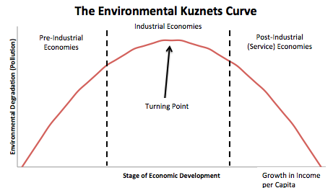
Example of an EKC

Slide 4
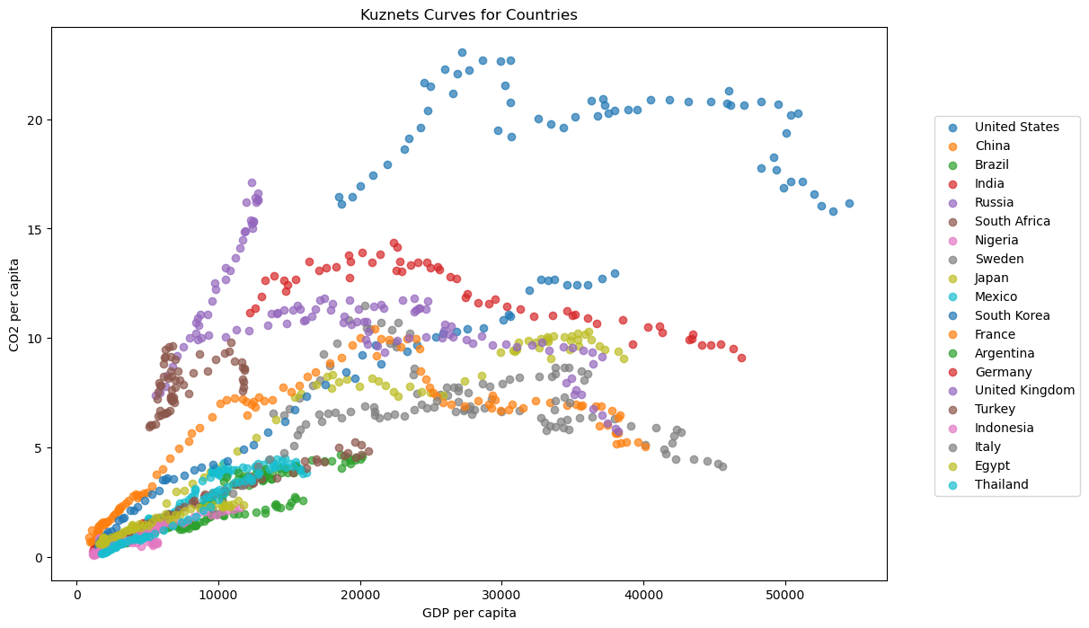
Kuznets Curves for countries on the same plot

Slide 5
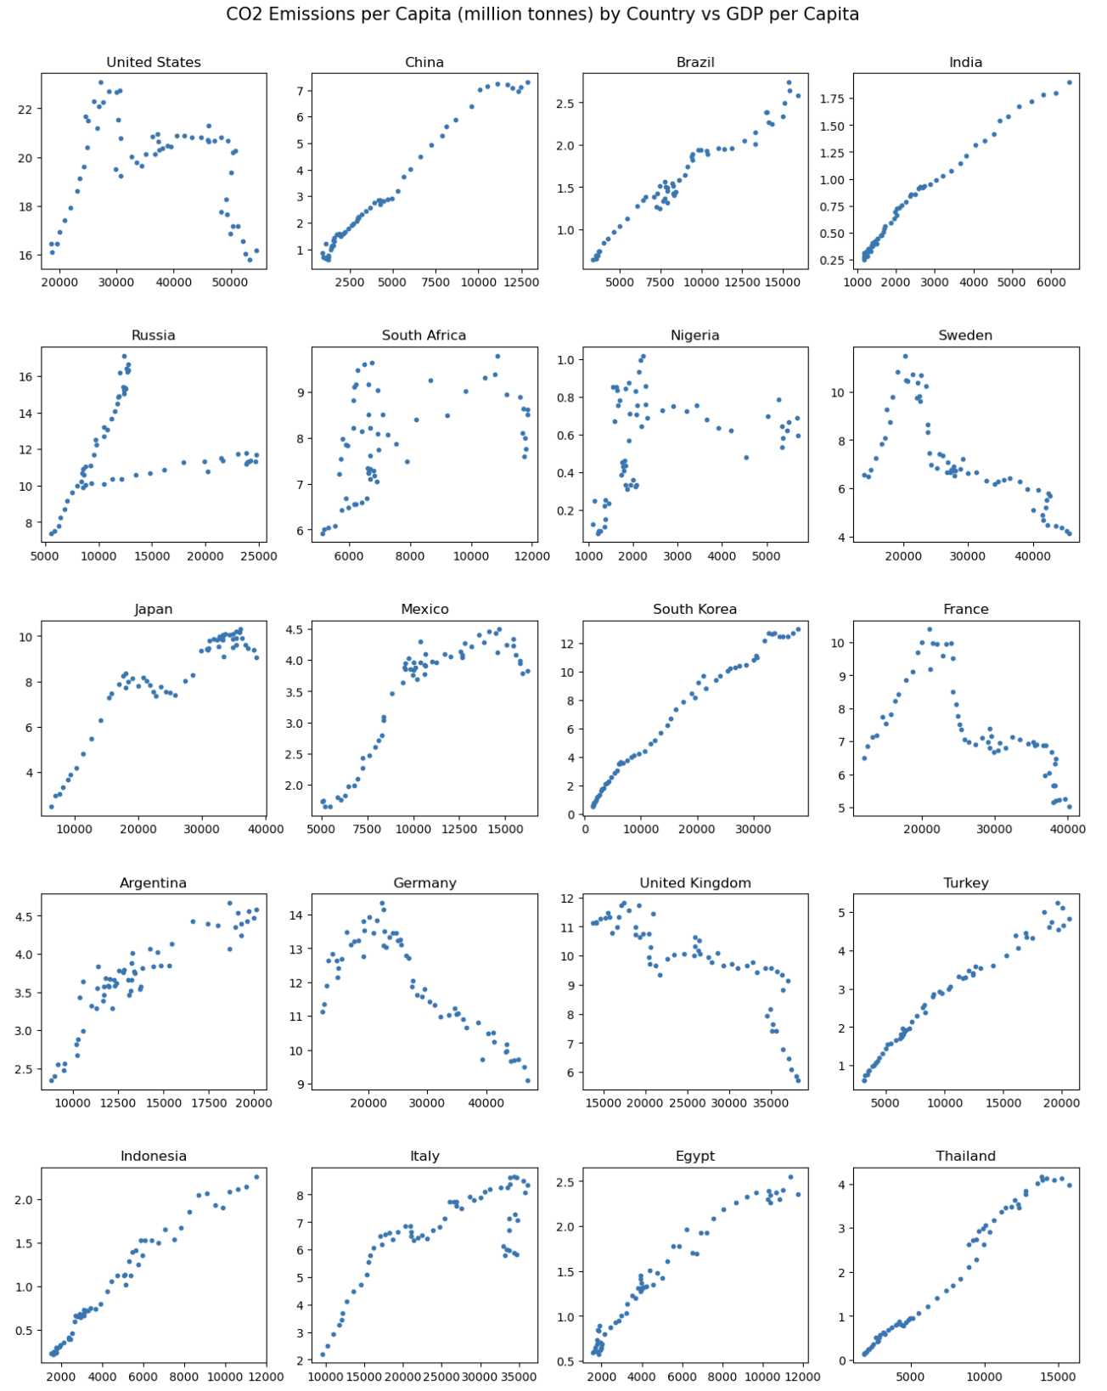
Individual Kuznets Curves

Slide 6
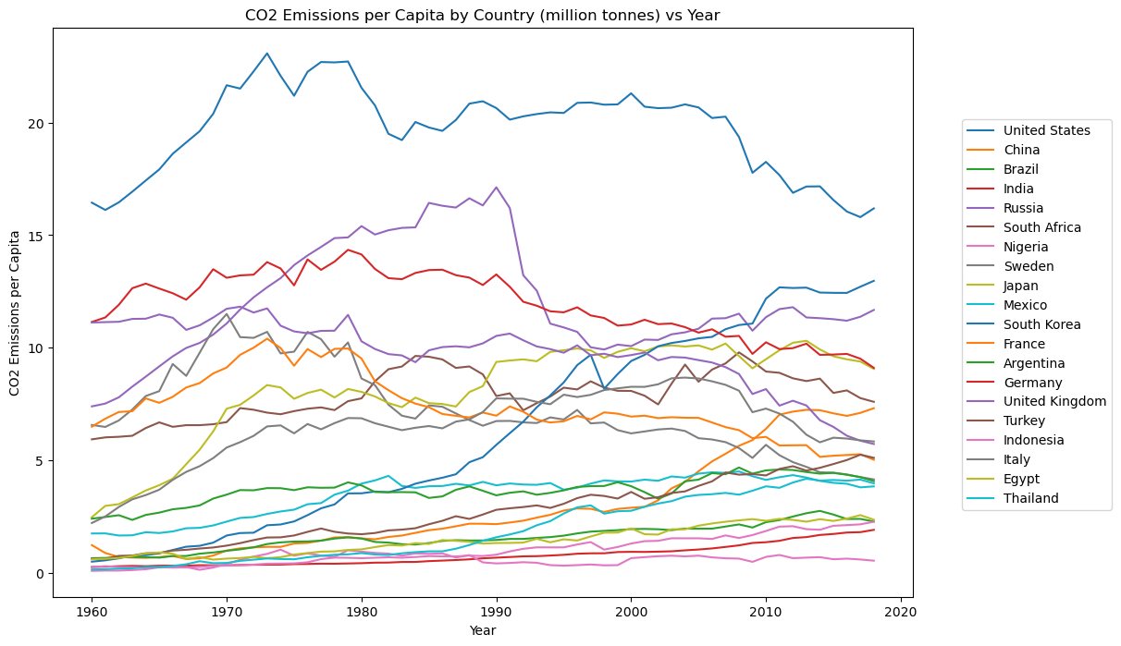
CO2 emissions per capita over time

Slide 7
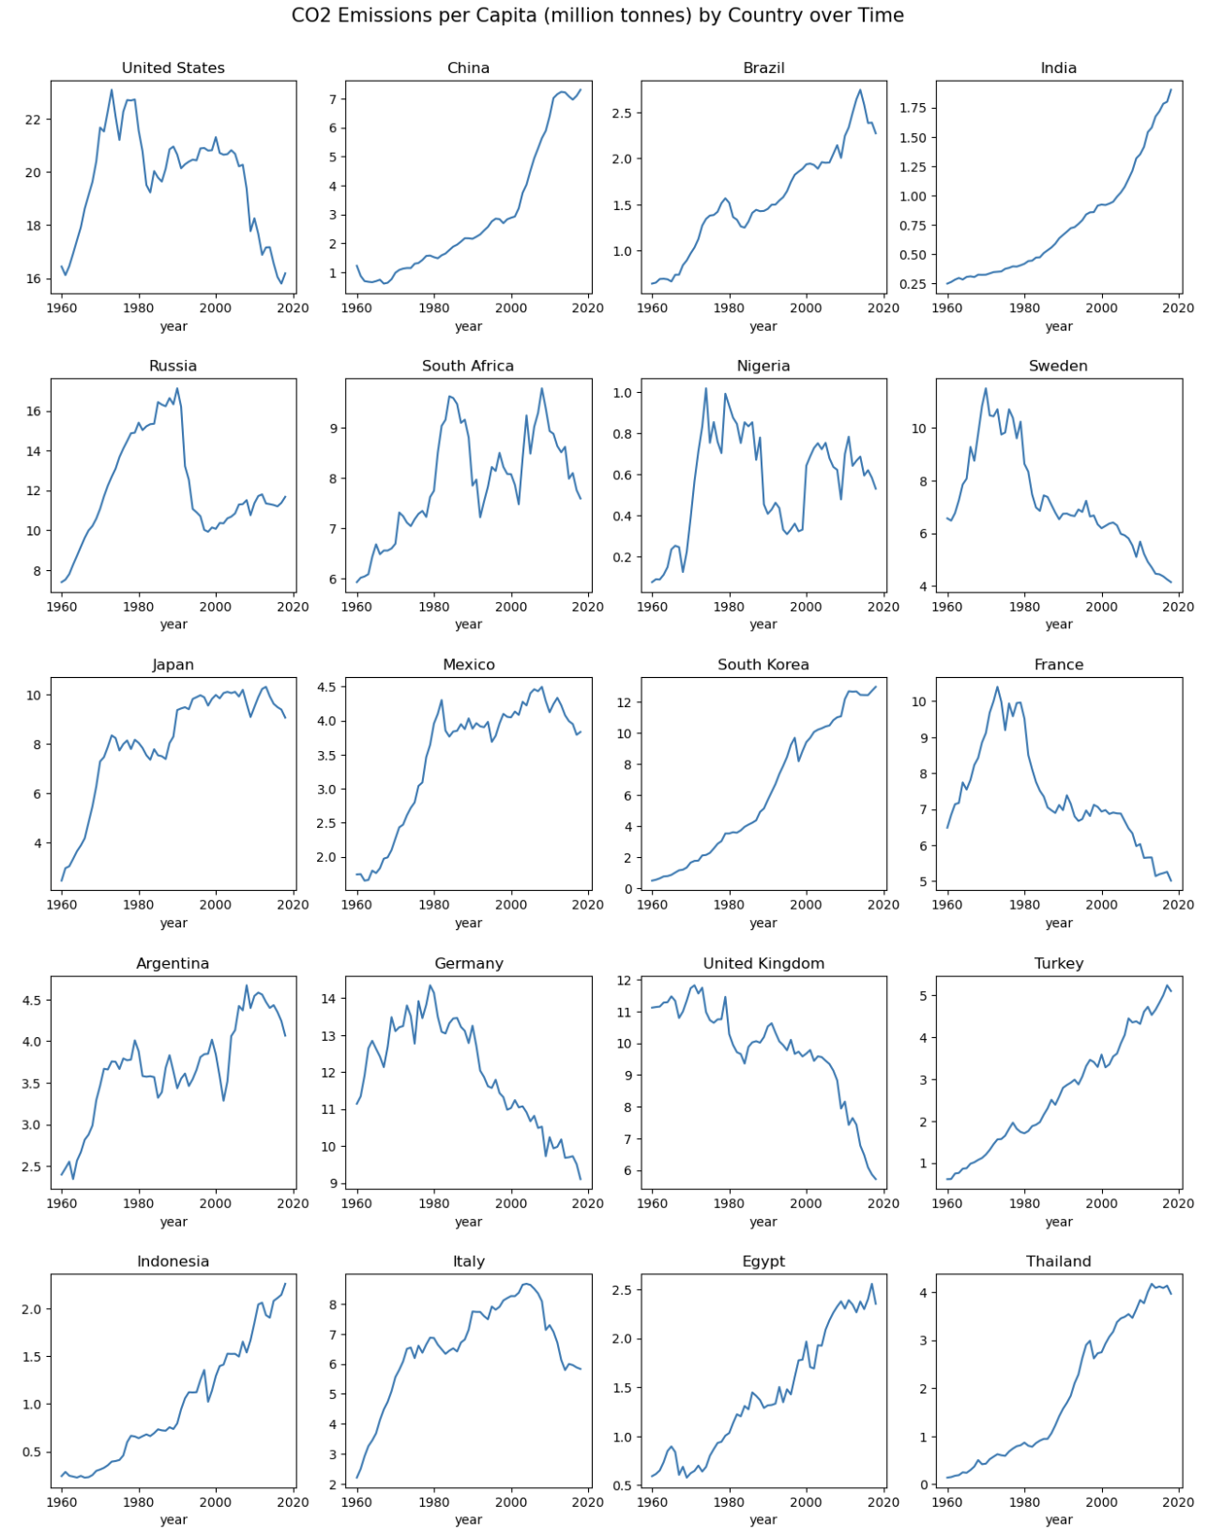
CO2 emissions per capita over time for all countries

Slide 8
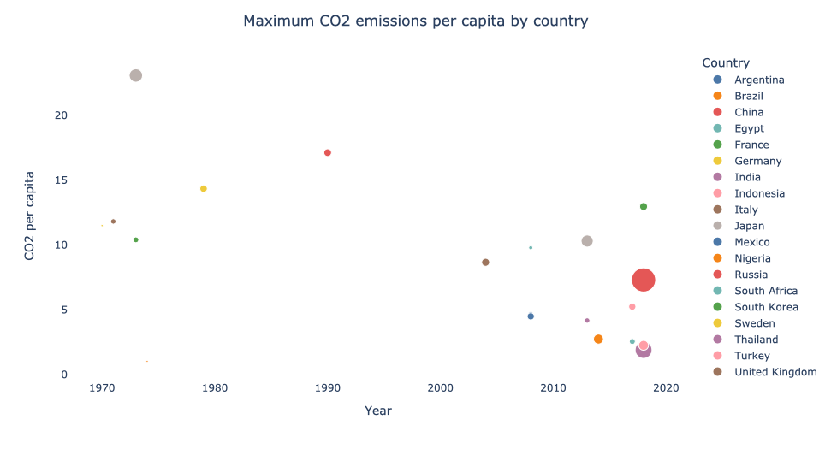
Bubble plot for CO2 emissions per capita, bubble size = GDP

Slide 9
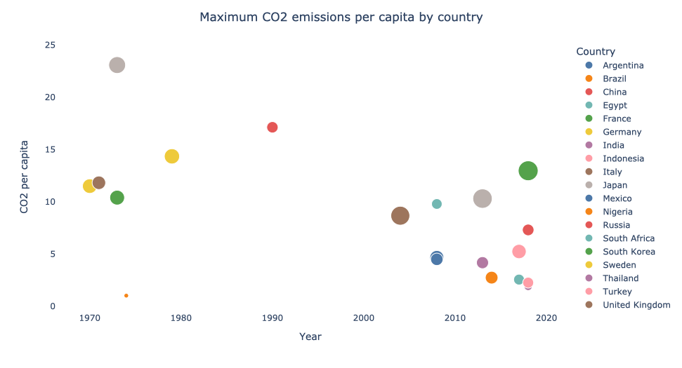
Bubble plot for CO2 emissions per capita, bubble size = GDP per capita

Slide 10
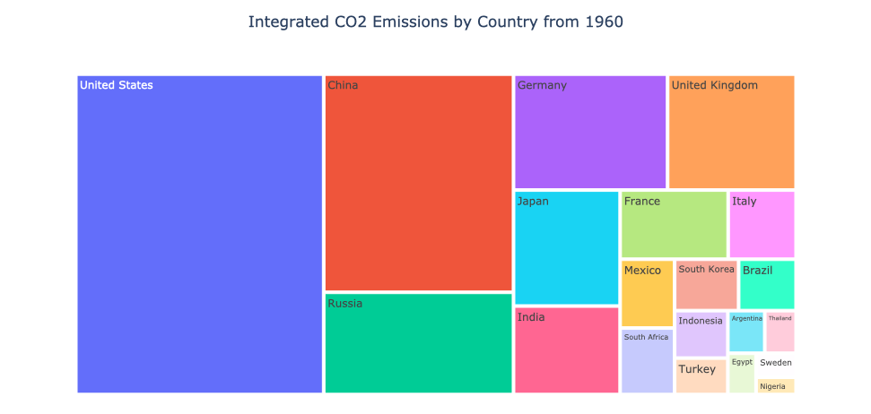
Tree chart showing integrated emissions from 1960 onwards

Slide 11
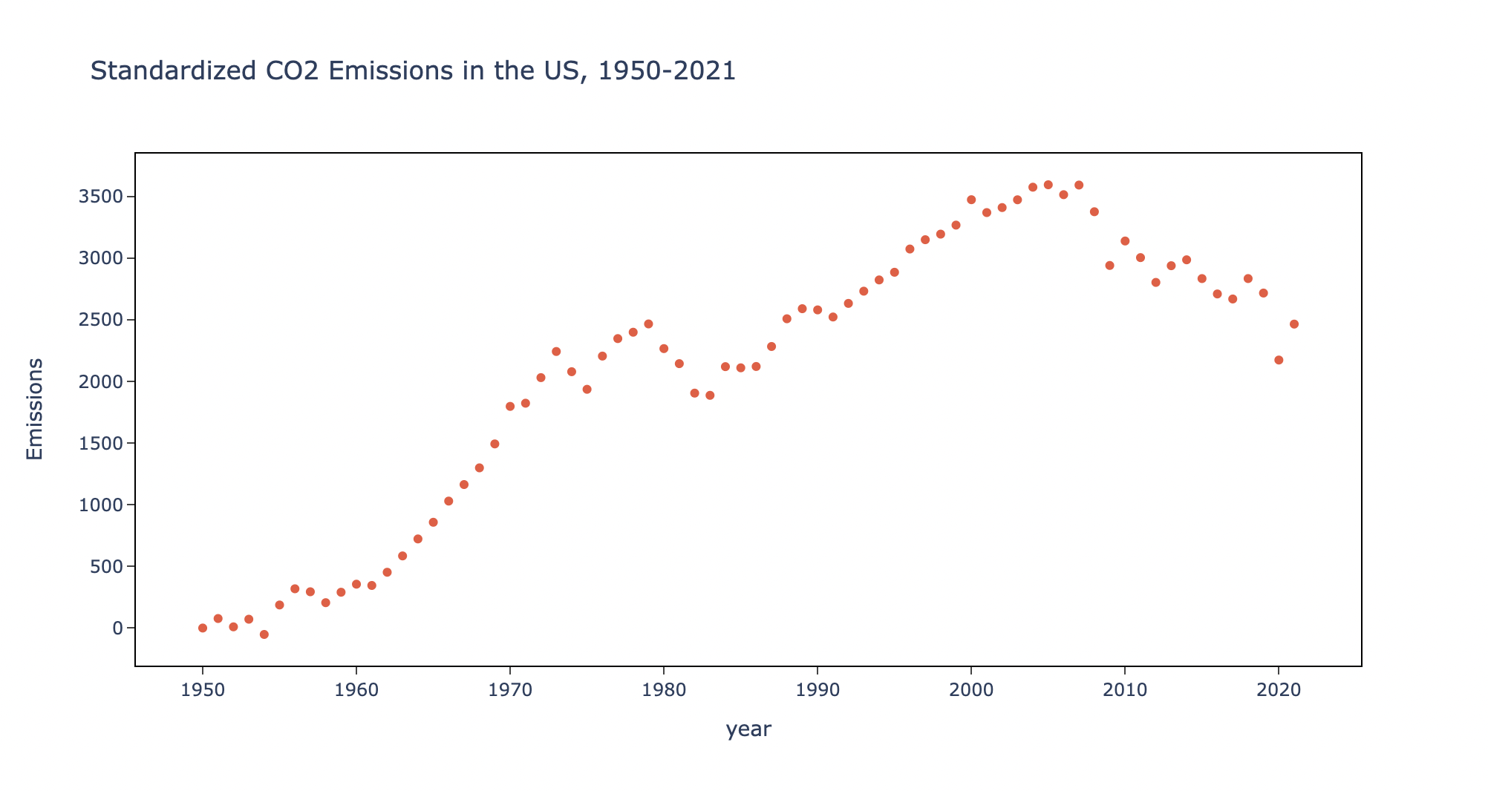

Slide 12
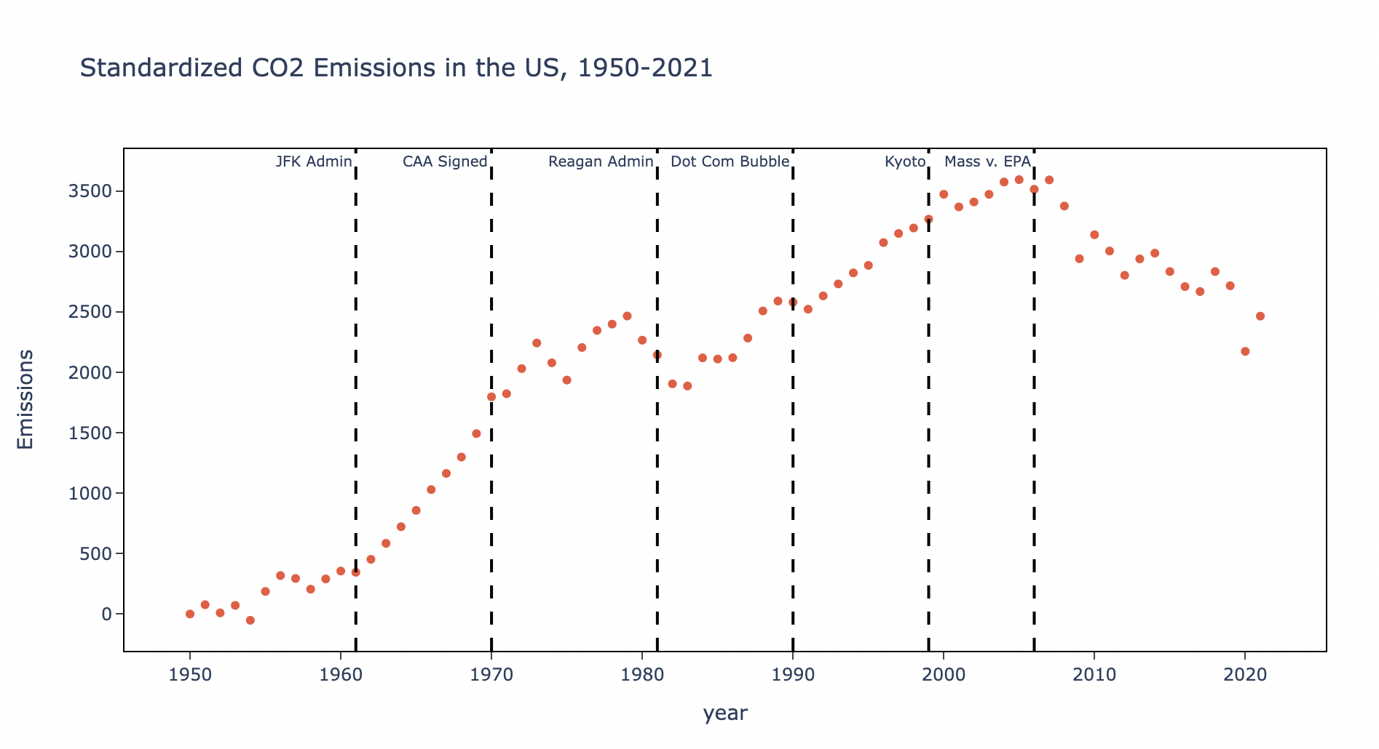

Slide 13
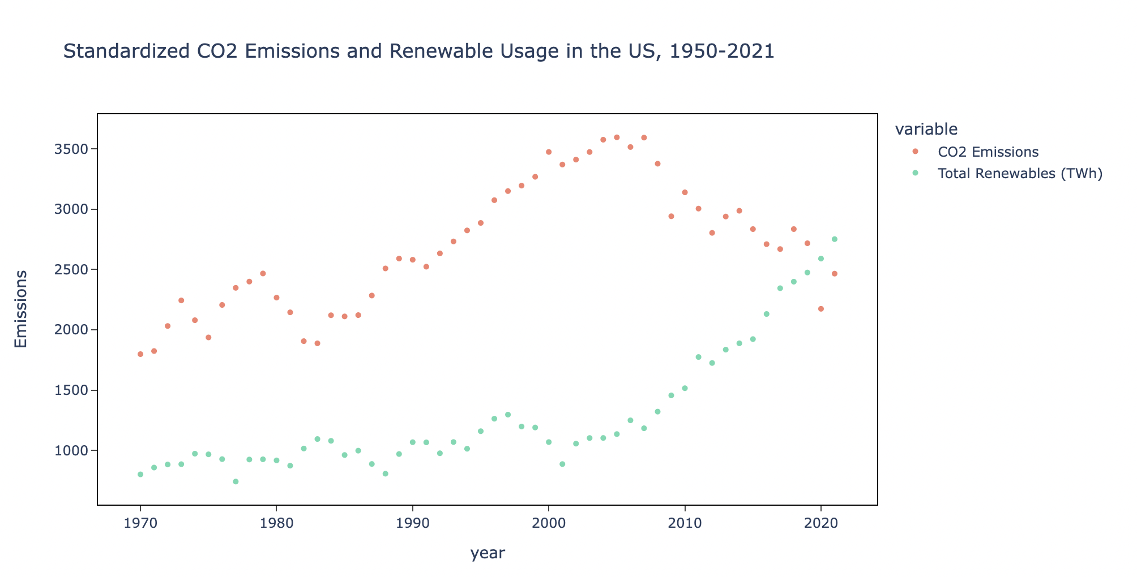

Slide 14
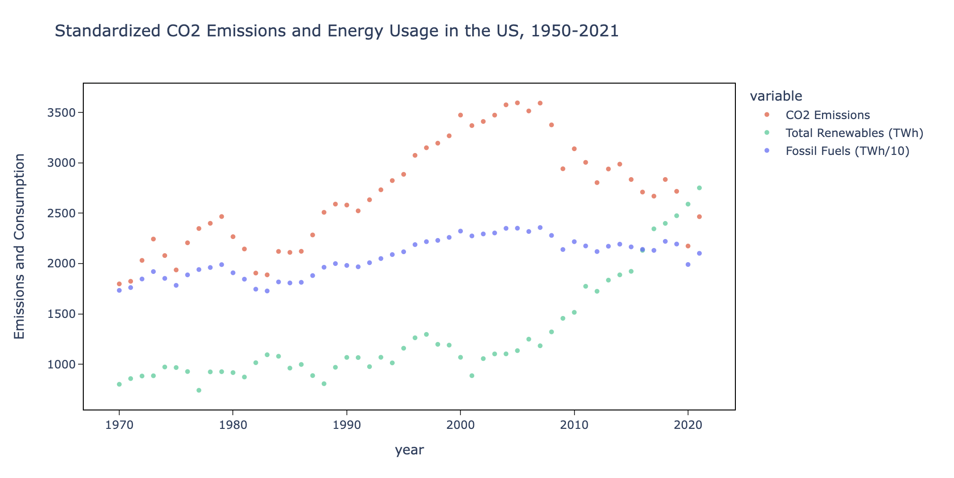

Slide 15
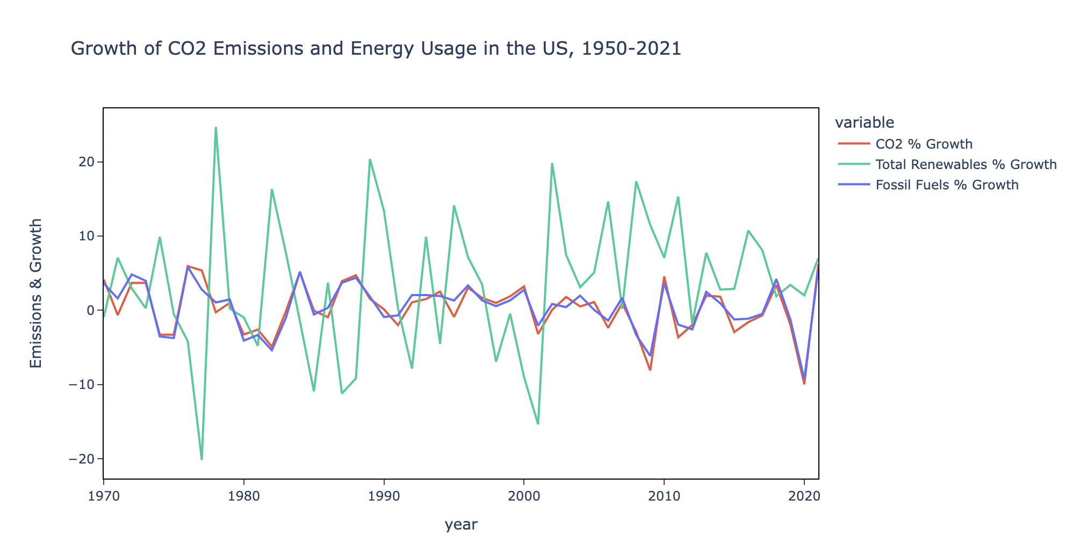

Slide 16
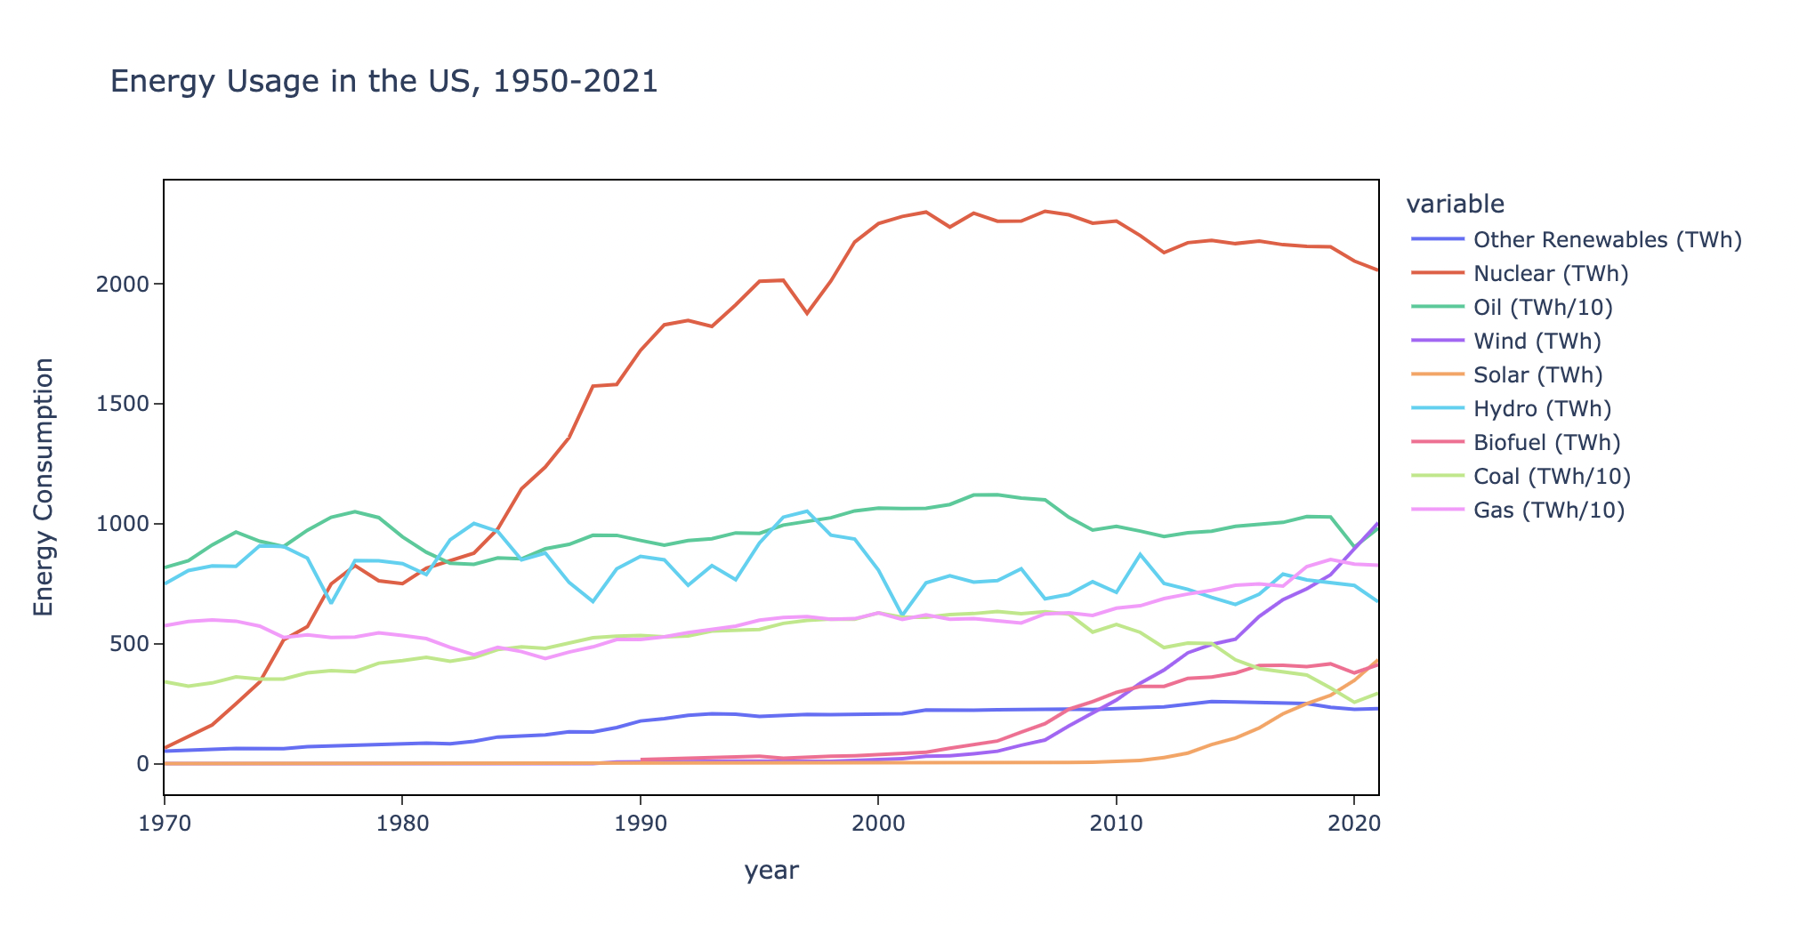

Slide 17
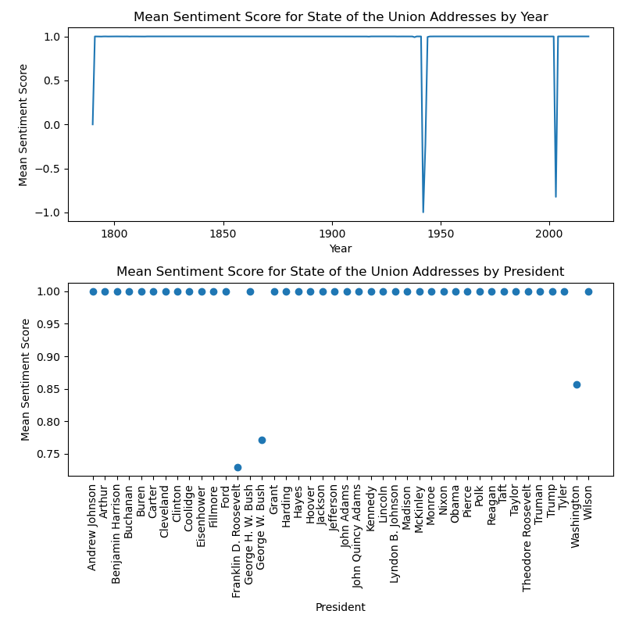

Slide 18
Sentiment Analysis
The Valence Aware Dictionary and Sentiment Reasoner (VADER)
The average sentiment score remains stable around 1 from 1790 to 2018. However, notable dips in sentiment are observed in 1790, during the 1940s, and in the first decade of the 21st century.
Most significant dips in sentiment mainly occurred during the administrations of Franklin D. Roosevelt, George W. Bush, and George Washington

Slide 19
Topic 0 | time | new | us | war | years | work | one | power | also | peace
Topic 1 | great | time | us | one | work | every | new | world | present | power
Topic 2 | great | present | one | state | new | time | years | war | every | system
Topic 3 | great | time | world | every | war | us | new | one | years | peace
Topic 4 | new | world | great | every | years | war | make | us | power | peace
Topic 5 | new | great | time | one | us | war | world | every | nations | years
Topic 6 | great | new | war | world | time | law | one | years | make | service
Topic 7 | great | war | time | one | world | new | present | make | every | nations
Topic 8 | one | great | us | law | present | state | act | new | world | general
Topic 9 | war | new | great | years | state | time | one | shall | every | power
Topic Modeling

Slide 20
Topic Modeling
Latent Dirichlet Allocation (LDA)
Topics generally revolve around themes such as time, war, newness, and greatness
Environmental concerns may not be a high-priority issue in State of the Union addresses.

Slide 21
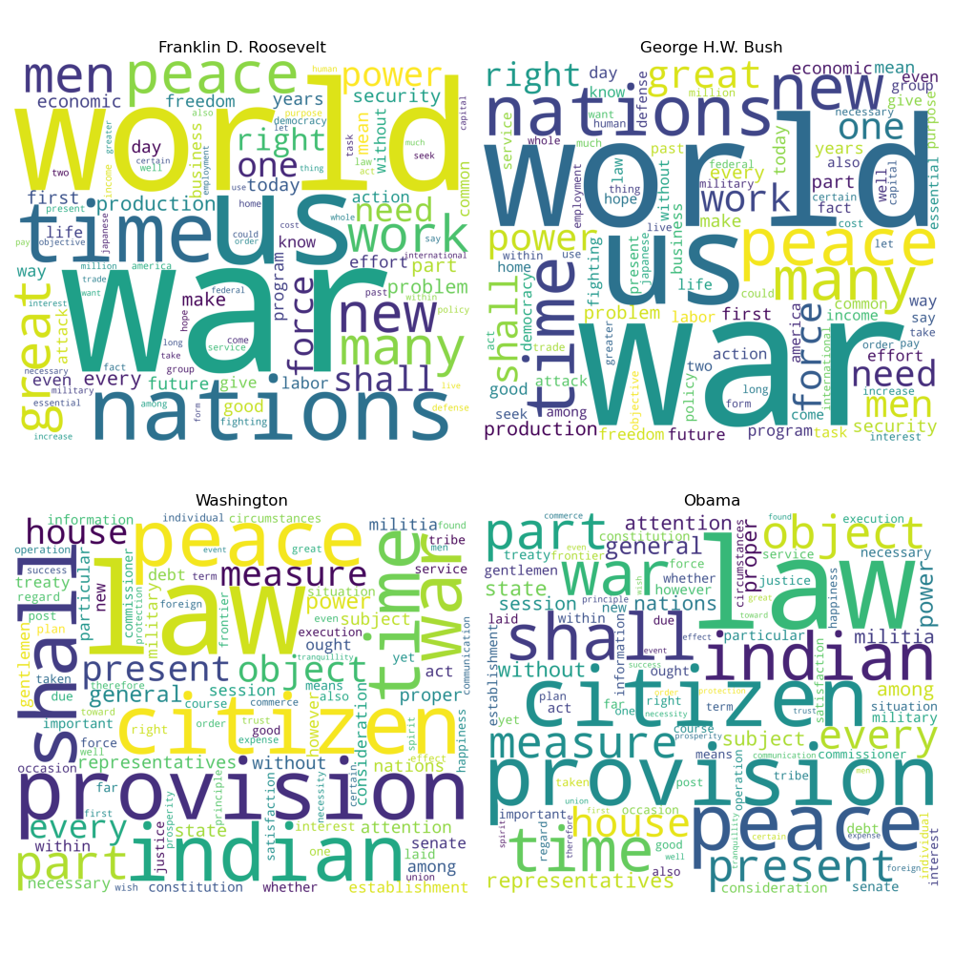
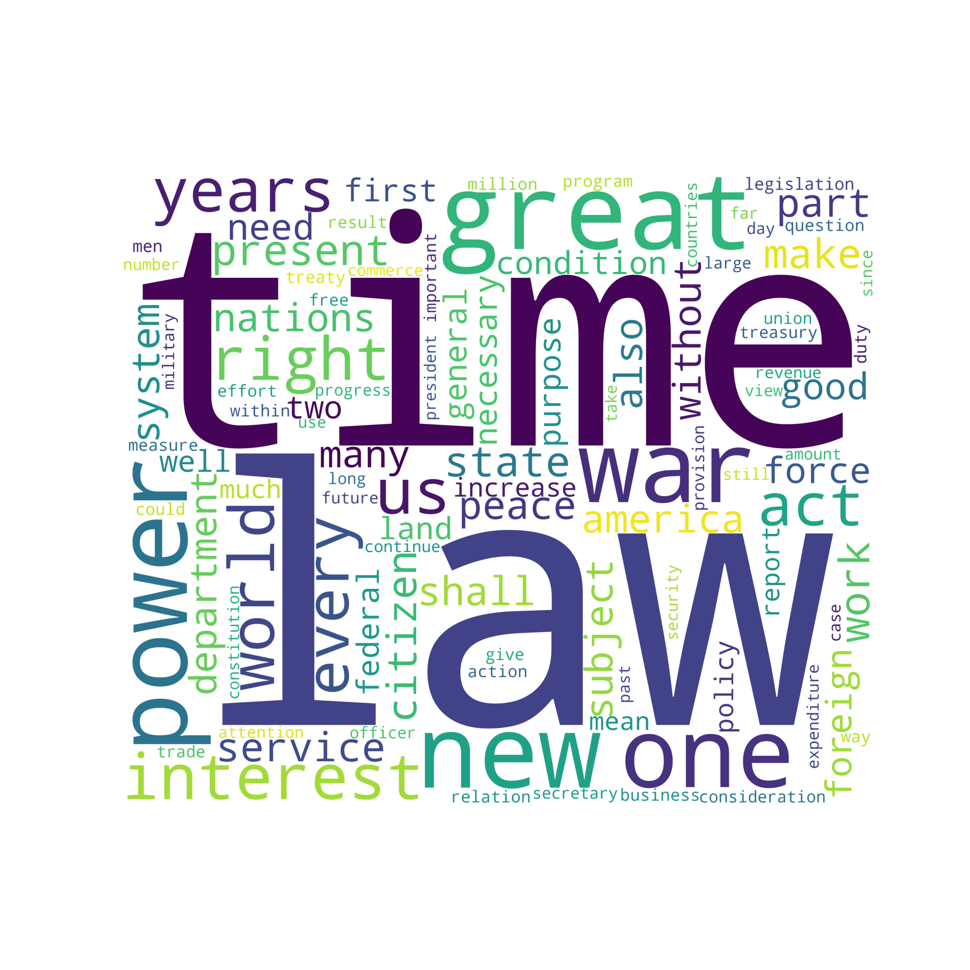
Word Cloud (all presidents)
Word Cloud (chosen presidents)

Slide 22
Word Clouds
Words such as "time," "law," "great," and "power" are the most common across all Presidents.
State of the Union primarily focuses on public issues and legislative regulations, while environmental concerns and CO2 emissions are not prominent topics in these statements.
The subplots for Franklin D. Roosevelt and George W. Bush reveal that "war" is the most frequent word in their State of the Union addresses.
Words featured in the addresses of Presidents Washington and Obama are more neutral.

